Slide 1
Data as tables: records,
variables and keys
What exactly is one row of a table, and how does one table connect to another?
AI and Data Science Professional | Session 2 of 24 | Module A: Think with data
KLAi Professional Learning | Jotham Martin Wambi
Notes:
Welcome back. Last session we drew the map of the whole course. Today we look closely at the thing every later session depends on, the table. You will open the Lakeside Mart workbook and learn to read a table the way a data scientist does: what one row stands for, how a column is measured, and how one table links to another.
These ideas decide whether a total you report is right or wrong, so we take our time.

Slide 2



Today in one view: what you will leave with
By the end of today you can
Say what one record stands for in a table (its granularity), and choose the right variable type for each variable
Find a primary key, a composite key and a foreign key, and read an entity relationship diagram
Test a table in Google Sheets for missing values and messy data, and write a data dictionary
Notes:
Here is what you can do by the end of today. You can say what one record of a table stands for, which is its granularity, and you can pick the right variable type for every variable. You can find a primary key, a composite key and a foreign key, and read a diagram that shows how tables link.
And you can test a table in Google Sheets for missing values and messy data, and then write a data dictionary. You will do all of it on the Lakeside Mart workbook, with no code.

Slide 3
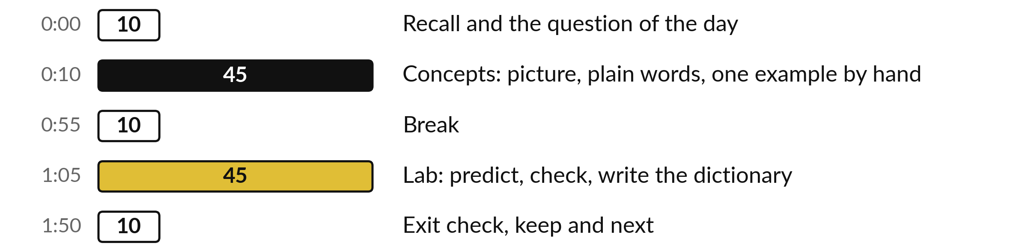
Your two hours: concepts
first, then a Google Sheets lab
Ideas with pictures first. Then you open the sheet. Then the checks and what you keep.
Notes:
We have two hours. The first ten minutes bring back Session 1 and set the question for today. Then forty-five minutes of concepts, with no laptops open, so you can watch the pictures. After a ten minute break we open the Lakeside Mart workbook in Google Sheets for a forty-five minute lab.
You will predict each answer, check it with a formula, and write what you find on a new tab. The last ten minutes are an exit check and what you keep. The lab is where the learning sticks, so please protect that time.

Slide 4

Three questions from last time
1. In CRISP-DM, which phase comes straight after business understanding, and what do you do in it?
2. In Excel words, what is a dataset, and how does a model differ from a formula?
3. An assistant gives you the share of orders paid by Mobile money. What do you do before you report it?
Answer aloud first. Then we check together.
Notes:
Three quick questions from Session 1. Answer aloud first, and then we check together. It is a warm-up to bring last time back.
Question one. In CRISP-DM, which phase comes straight after business understanding, and what do you do in it?
A good answer is this. Data understanding: find the tables that could answer the question and check what they mean.
Question two. In Excel words, what is a dataset, and how does a model differ from a formula?
A good answer is this. A dataset is a workbook in which each tab is one table. A model is a rule found from data, where a formula is typed by a person.
Question three. An assistant gives you the share of orders paid by Mobile money. What do you do before you report it?
A good answer is this. Recompute it from your own data: 48.8 percent, 976 of 2,000. Write the source beside it.
If you missed one, check your notes from last session tonight. Now to today.

Slide 5



Answers to the three questions from Session 1
Question | Short answer
In CRISP-DM, which phase comes straight after business understanding, and what do you do in it? | Data understanding: find the tables that could answer the question and check what they mean.
In Excel words, what is a dataset, and how does a model differ from a formula? | A dataset is a workbook in which each tab is one table. A model is a rule found from data, where a formula is typed by a person.
An assistant gives you the share of orders paid by Mobile money. What do you do before you report it? | Recompute it from your own data: 48.8 percent, 976 of 2,000. Write the source beside it.
Notes:
Here are the answers to the three warm-up questions. After business understanding, the next CRISP-DM phase is data understanding. You cannot answer a question until you know which tables could answer it and what they mean, and that is exactly where we are today. A dataset, in Excel words, is a workbook where each tab is one table, and a model is a rule found from data where a formula is typed by a person.
And an assistant predicts likely words, so it can state a share that nobody calculated. Recompute it from your own data and write the source beside it. Which of the three did you find hardest?

Slide 6





Words we use today
Word | What it means
Record (observation, instance, row) | One row of a table: one thing the table describes. In the orders tab each record is one till order.
Granularity (grain) | The level of detail of a table: one record per order, per order line or per branch per week.
Variable type and data type | Variable type: how a variable is measured (numeric, categorical, datetime, text). Data type: how the cell stores it (integer, float, string). They are different ideas.
Primary key and foreign key | A primary key never repeats and names one record. A foreign key holds the primary key of another table and links the two.
Missing value (NaN, NULL) | A cell with no value. Ask whether it means unknown, not applicable or something real. Informative missingness: the blank itself is a fact, such as a walk-in shopper.
Notes:
Five words for today. I give the plain meaning of each, and we use every one of them before the end of the session.
Record (observation, instance, row). One row of a table: one thing the table describes. In the orders tab each record is one till order.
Granularity (grain). The level of detail of a table: one record per order, per order line or per branch per week.
Variable type and data type. Variable type: how a variable is measured (numeric, categorical, datetime, text). Data type: how the cell stores it (integer, float, string). They are different ideas.
Primary key and foreign key. A primary key never repeats and names one record. A foreign key holds the primary key of another table and links the two.
Missing value (NaN, NULL). A cell with no value. Ask whether it means unknown, not applicable or something real. Informative missingness: the blank itself is a fact, such as a walk-in shopper.

Slide 7
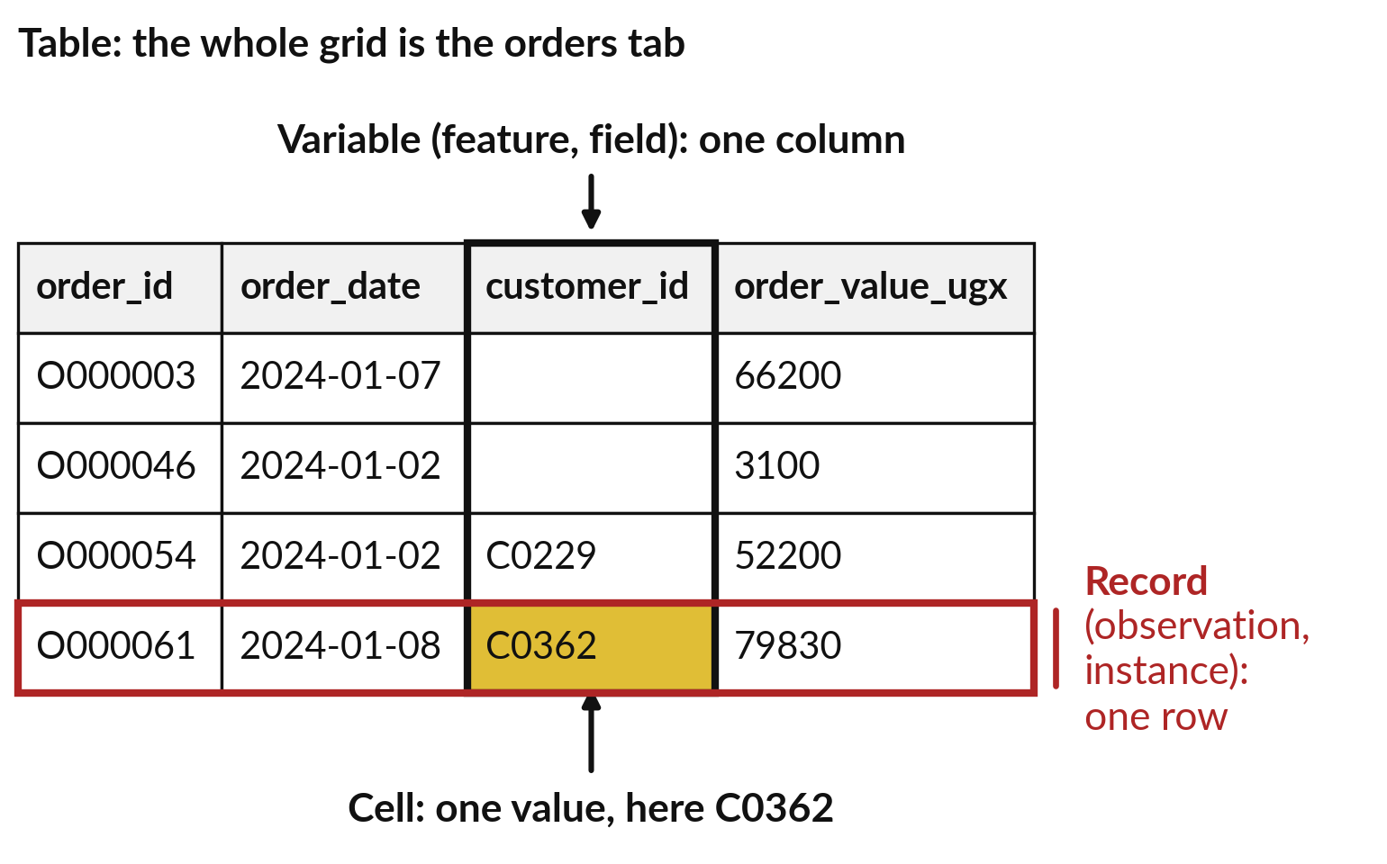
A table holds records in rows
and variables in columns
A record is one row. A variable is one column.
Record (observation, instance): one row. Here, one till order.
Variable (feature, field): one column.
Cell: one value of one variable in one record.
Notes:
Here are the first four rows of the orders tab of the Lakeside Mart workbook. The whole grid is one table. Each column is a variable, which is one fact recorded for every order, such as the order date. Each row is a record. Data scientists also call it an observation or an instance, and in machine learning you will hear instance.
In this table each record is one till order. And a cell is a single value, one variable for one record. Look at the gold cell: it holds the customer id of the fourth order. Notice two empty cells in the customer column. We come back to them.
Can you point to one record on the slide?

Slide 8





The spreadsheet word and the
data science word for each part
In a spreadsheet | In data science | Plain meaning
Row | Record (observation, instance) | One thing the table describes, such as one till order.
Column | Variable (feature, field, attribute) | The same fact about every record, such as branch_id.
Cell | Value | One variable for one record.
Tab | Table (a DataFrame in pandas) | All the records of one kind.
Workbook | Dataset or database | Tables that belong together.
In machine learning a variable is either a feature (an input) or the target (the answer you predict).
Notes:
You already know every part of a table from Excel, so here is the translation. A row is a record, also called an observation or an instance. A column is a variable, also called a feature, a field or an attribute. A cell holds a value. A tab is a table, and in pandas, the Python library we meet in Session 7, a table is called a DataFrame.
A whole workbook is a dataset, or a database when it is stored in a system. The words differ between statistics, databases and machine learning, but the idea is the same. When you read documentation or a job advert, this table is your dictionary. Which of these words was new to you?

Slide 9
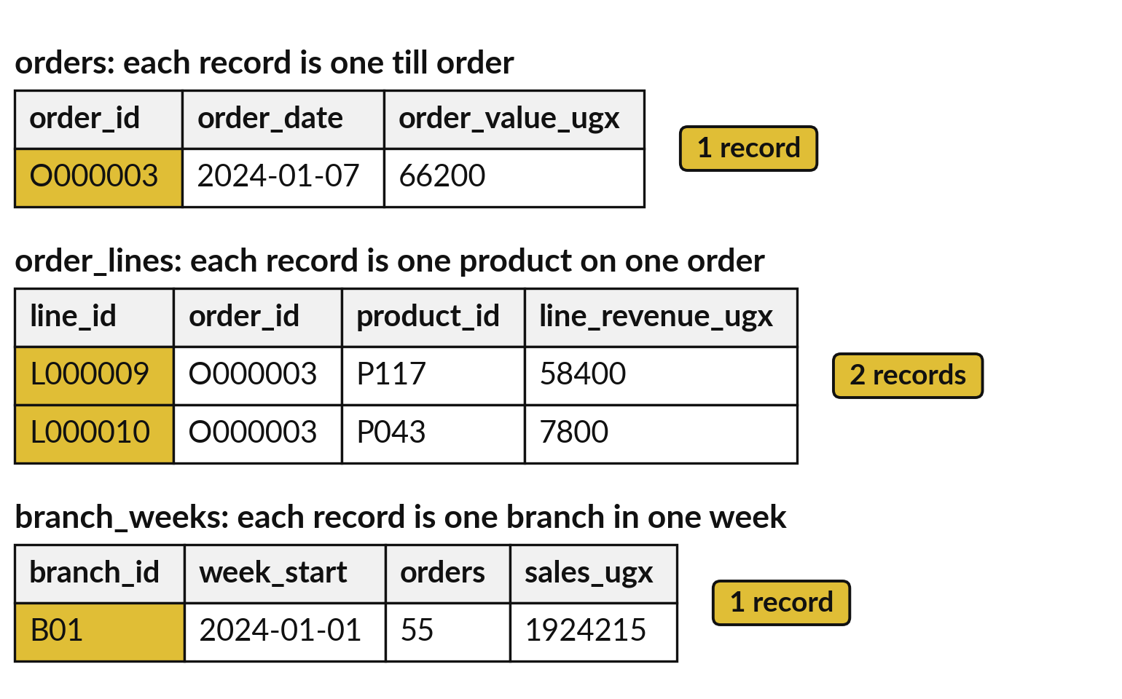
Granularity is the level of detail: one record per
order, per order line or per branch per week
Granularity is the level of detail of a table. It says what one record stands for.
The unit of observation is what one record stands for.
Data warehouse teams call the level of detail the grain.
Finish this sentence first: each record is one ...
Notes:
Now the question in the title of today: what exactly is one row?
The standard name is granularity, the level of detail of a table. What one record stands for is called the unit of observation. People who build data warehouses call this the grain, so if a colleague says grain, they mean the same thing. Look at the picture. The same order, O000003, appears at three levels.
In orders it is one record. In order_lines it is two records, one for each product. And branch_weeks has one record for a whole branch and a whole week. Before you count or total anything, finish the sentence: each record is one what?

Slide 10






Each of the six tabs has its
own record and its own count
Tab | Each record is | Records | Variables
orders | one till order | 2,000 | 7
order_lines | one product on one order | 6,590 | 7
products | one product | 150 | 5
branches | one branch | 8 | 5
customers | one loyalty customer | 2,500 | 5
branch_weeks | one branch in one week | 832 | 7
The workbook holds a 2,000-order sample of the full Lakeside Mart file. Records are counted without the header row.
Notes:
Here are the six data tabs of your workbook, each with its unit of observation. Orders has 2,000 records, one per till order. Order lines has 6,590, one per product on an order. Products has 150, branches has 8, customers has 2,500 loyalty customers, and branch weeks has 832, one for each branch in each week.
There is also a seventh tab called READ ME, which is only a note. The workbook holds a sample of two thousand orders from the full file, so totals here will differ from the full file. Session 4 explains why. In the lab you will write this table yourself on a new tab.

Slide 11
Counting records in the wrong tab:
6,590 lines are not 6,590 orders
Wrong
Right
order_lines has 6,590 records.
Reporting that as the number of orders counts every product on every order.
Count the orders tab: 2,000 orders.
Or count each order_id once in order_lines: 2,000.
That is 3.3 lines per order on average.
State the granularity first. Then count.
Notes:
This is the most common mistake with tables. You open the order lines tab, you see 6,590 rows, and you tell your manager the shop sold 6,590 orders. Nothing warns you. But a record in order lines is one product on one order, and a basket of five products adds five records.
The orders tab has 2,000 orders, and the lines average 3.3 per order, which is 6,590 divided by 2,000. To count each order once in the order lines, use COUNTA of UNIQUE of the order id range. So say the granularity first, then count. Which tab would you count to get the number of customers who bought something?

Slide 12
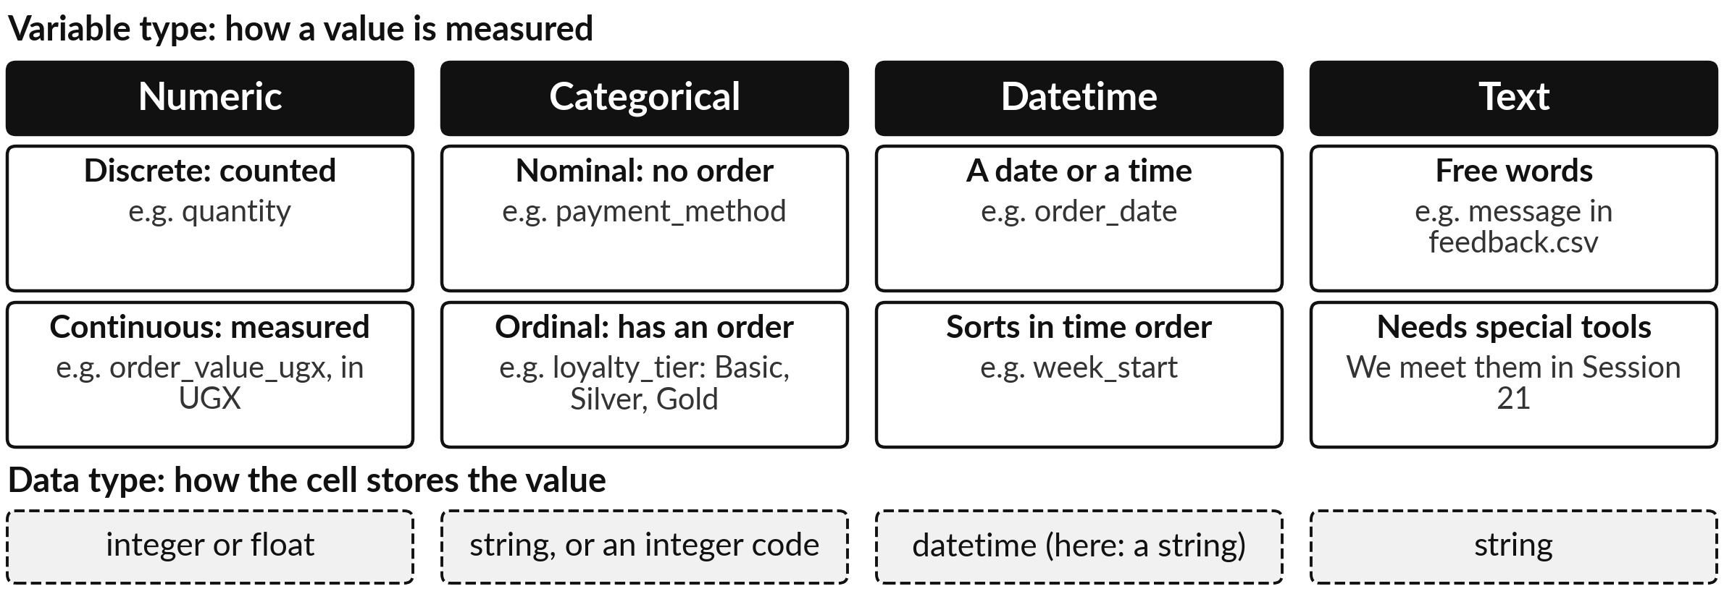
Every variable has a variable type (how it is
measured) and a data type (how it is stored)
Discrete: counted. Continuous: measured. An identifier (order_id) is a label: never add it up.
Notes:
Every variable has two kinds of type, and people mix them up. The variable type is how the value is measured. Numeric values are numbers you can add. They are discrete when you count them, like quantity, and continuous when you measure them, like money. Categorical values are labels.
They are nominal when there is no order, like payment method, and ordinal when there is an order, like Basic, Silver and Gold. Datetime values are dates and times, and text is free words. The data type is how the cell stores it: integer, float, string or datetime.
A date can be stored as a string, and we will see that happen in this workbook. An identifier such as order_id or customer_id names a record, so you never add it up. Which type is branch_id?

Slide 13







The seven variables of the
orders tab and their types
Variable | Example (order O000054) | Data type in this workbook | Variable type
order_id | O000054 | string | identifier (a label)
order_date | 2024-01-02 | string: not a real date | datetime
branch_id | B01 | string | categorical (nominal)
customer_id | C0229 | string, 580 blank | identifier, with missing values
payment_method | Cash | string | categorical (nominal)
promo_week | 0 | integer | categorical (a 0 or 1 flag)
order_value_ugx | 52200 | integer | numeric (continuous, UGX)
An identifier can look like a number or a code. You never add it up.
Notes:
Now we apply both kinds of type to the seven variables of the orders tab. Order_id and customer_id are identifiers, labels that name something, and you never average a label. Order_date should be a datetime, but in this workbook it is stored as a string, which is text.
We test that in the lab with a function called ISNUMBER. Branch_id and payment_method are categorical with no order. Promo_week is stored as an integer, but it only holds zero or one, so it is a categorical flag. And order_value_ugx is numeric, a continuous amount in shillings. Why does the type matter?
Because it decides which questions make sense. Would an average of branch_id mean anything?

Slide 14
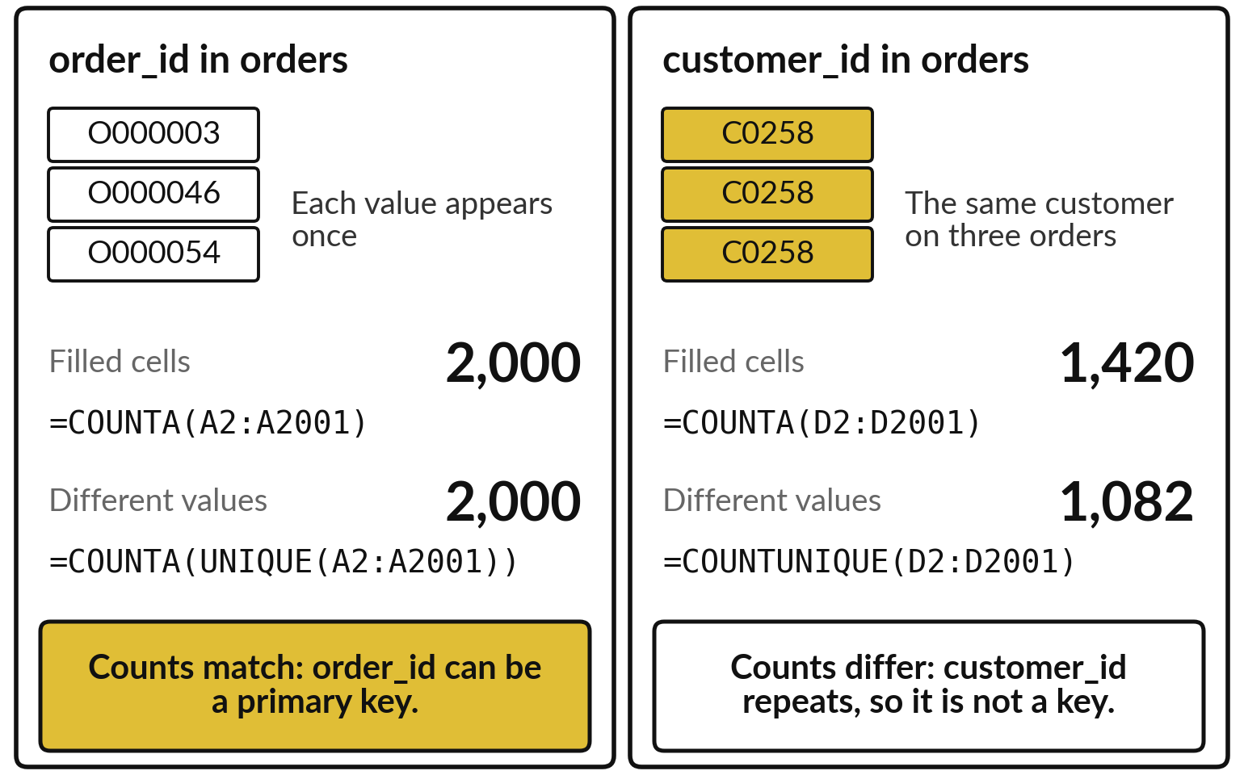
A primary key is a variable that
is different in every record
Primary key: a variable whose value is different in every record, so it names exactly one record.
Test it: count the filled cells, then count the different values.
If the two counts match, it can be a primary key.
order_id passes. customer_id repeats, so it fails.
Notes:
A primary key is a variable whose value never repeats, so it names exactly one record, like an invoice number in Excel. You can test a candidate in two steps. First count the filled cells with COUNTA. Then count the different values with COUNTA of UNIQUE, a Google Sheets formula.
For order_id both counts are 2,000, so order_id is the primary key of the orders tab. For customer_id the first count is 1,420 and the second is only 1,082. Some customers ordered more than once, so the value repeats. Customer_id is not a key of the orders tab.
With blanks in a range, use COUNTUNIQUE in Sheets. Which variable would you test as the key of the order lines tab?

Slide 15
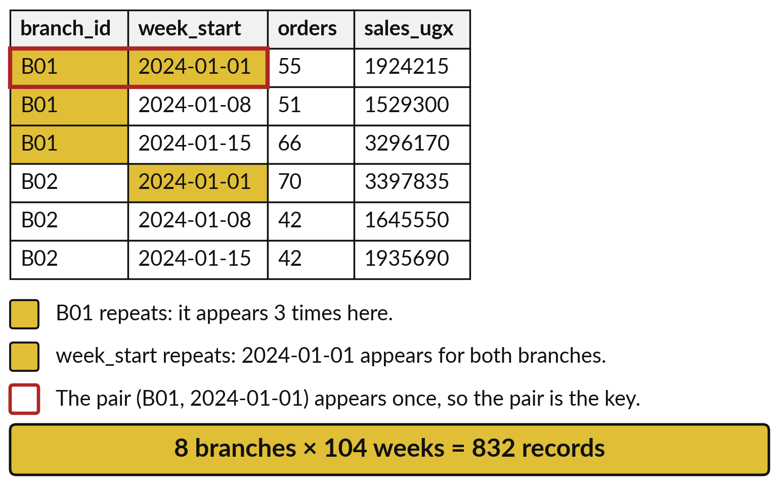
Two variables together can form a composite key
Composite key: two or more variables that are unique together, although each repeats alone.
branch_id repeats: every branch appears once per week.
week_start repeats: every week appears once per branch.
Each pair appears once, so the pair is the key: 832 records.
Notes:
Sometimes no single variable is unique. Look at the branch weeks tab. Branch_id repeats, because every branch appears in every week. Week_start repeats too, because every week appears for every branch. But the pair, branch and week together, never repeats. That is a composite key. There are 8 branches and 104 weeks, and 8 times 104 is 832, which is exactly the number of records in the tab.
The product matches the record count, which fits with every pair appearing once but does not prove it. The proof is to count the distinct pairs and get the same number again, which you do in the lab. Where else might you meet a pair like this at work?

Slide 16
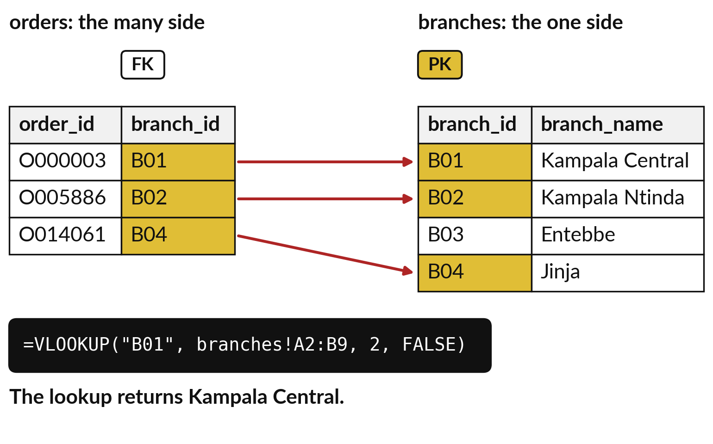
A foreign key holds the primary key
of another table and links the two
Foreign key: a variable whose values are primary keys of another table.
branch_id in orders is a foreign key. branch_id in branches is the primary key.
Look up B01 in branches to find the branch name.
In SQL and pandas this lookup is called a join or a merge.
Notes:
A foreign key is a variable in one table that holds the primary key of another table. Look at the picture. The orders tab on the left has a branch_id on every order. That branch_id is a foreign key. The branches tab on the right has one record per branch, and there branch_id is the primary key.
Each arrow goes from an order to the one branch record it belongs to. You already do this lookup in Excel with VLOOKUP or XLOOKUP, where B01 returns Kampala Central. In SQL and in pandas the same step is called a join or a merge, and we meet it in later sessions.
Which other variable in orders is a foreign key?

Slide 17
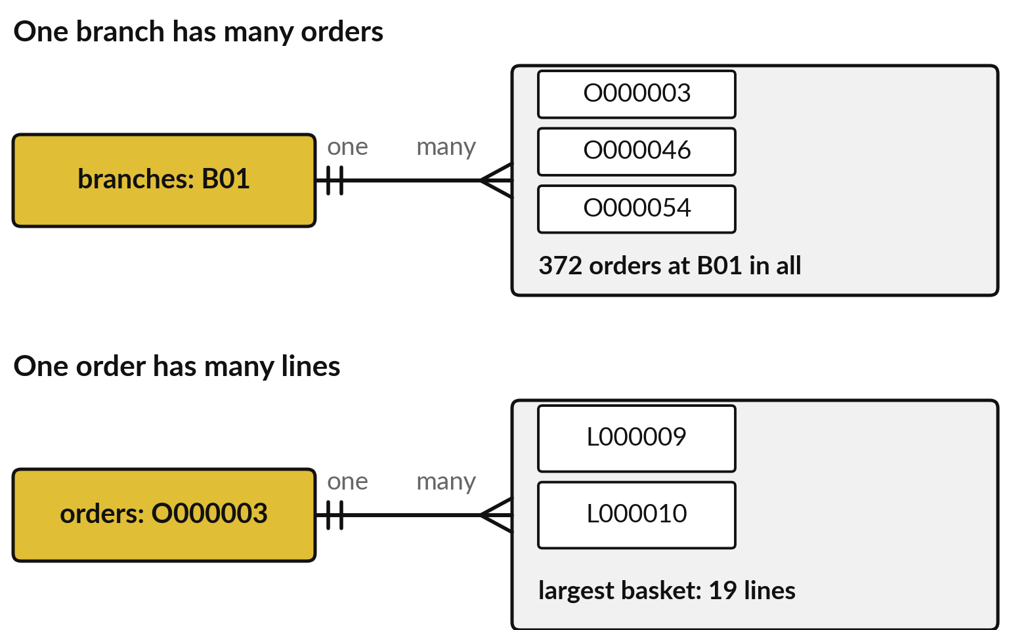
Tables relate one-to-many: one branch has
many orders and one order has many lines
A relationship says how records of two tables match. The common kind is one-to-many.
One branch has many orders: B01 has 372.
One order has many lines: O000003 has 2.
Many-to-many: orders and products, joined by the junction table order_lines.
Notes:
A relationship says how the records of two tables match. The most common kind is one-to-many. One branch has many orders: in this sample branch B01 has 372. One order has many lines: order O000003 has 2, and the largest basket in the sample has 19. Read from the other side it is many-to-one: many orders belong to one branch.
The lines on the picture end in three prongs on the many side. There is a third kind, many-to-many. Products and orders are like that, because a product appears on many orders and an order has many products. The order lines tab sits in between as a junction table, also called a bridge table, and turns it into two one-to-many links.
Is customers to orders one-to-many?

Slide 18
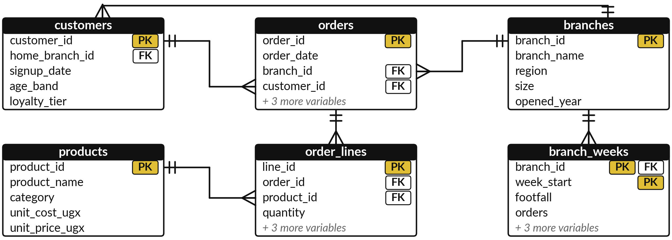
An entity relationship diagram (ERD)
draws the six tabs and how their keys link
PK marks a primary key and FK a foreign key. A line ends in three prongs on its many side.
Notes:
This picture is an entity relationship diagram, or ERD. It is the standard way to draw how tables link. Each box is a table, with its primary key marked PK and its foreign keys marked FK. Each line is a one-to-many relationship, and the three prongs sit on the many side.
Orders points to customers and to branches. Order lines points to orders and to products. Branch weeks points to branches, and its branch id is part of a composite key. Customers also holds a home branch id that points to branches, which is the line that goes over the top.
Each box shows only some of its variables. Which table would you start from to find the branch of a product sold?

Slide 19
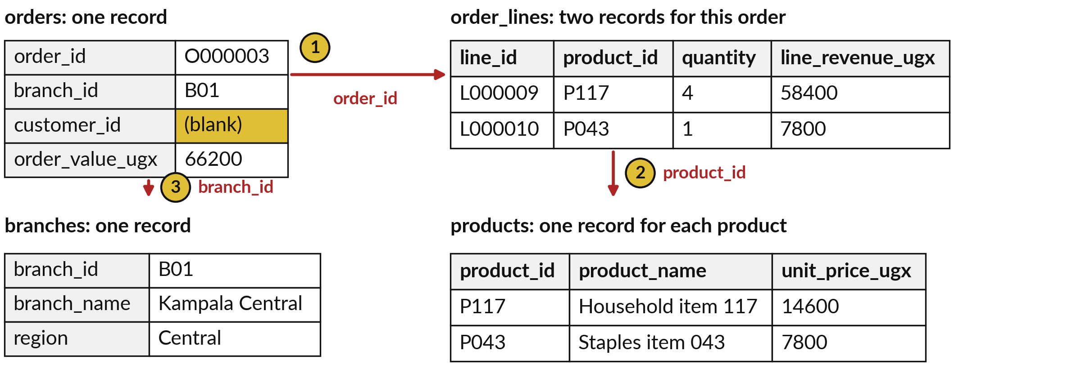
Follow order O000003
through four tabs by their keys
customer_id is blank, so this order has no row in customers: it was a walk-in.
Notes:
Let us follow one order through the tabs using only keys. Start in the orders tab: order O000003, at branch B01, with a value of 66,200 shillings. Step one, look up its order_id in the order lines tab. You find 2 lines, for products P117 and P043. Step two, look those product ids up in the products tab to get their names.
Step three, look the branch id up in branches: Kampala Central. The two line amounts, 58,400 and 7,800, add up to 66,200, the order total. The customer id is blank, so there is no customer to look up. Why do you think that is?

Slide 20
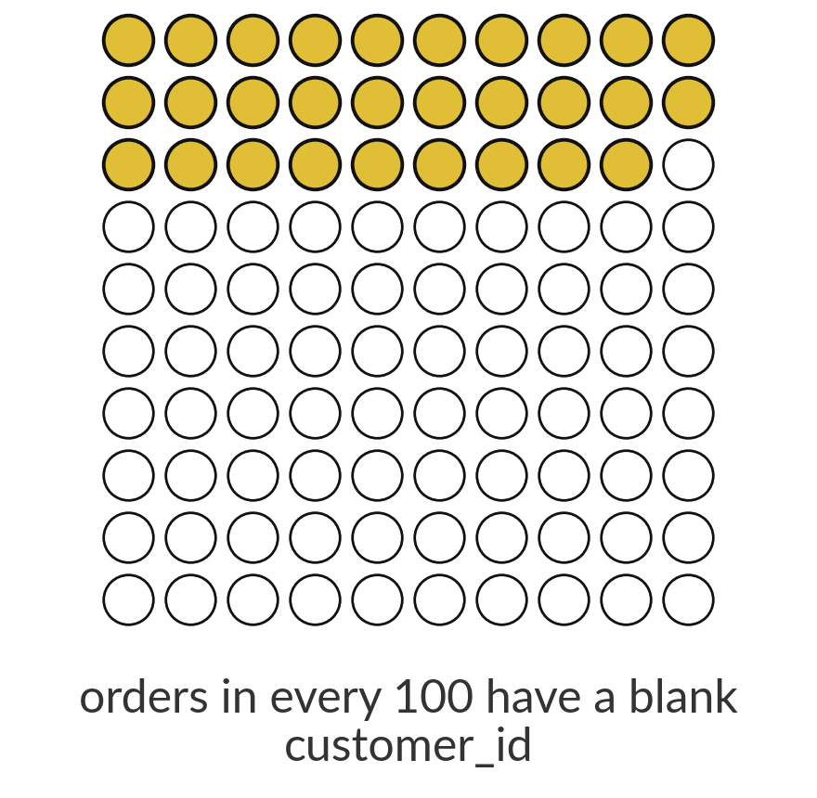
A blank customer_id is a missing value,
and it appears on 29 percent of orders
29%
580 of the 2,000 orders have no customer_id. The data dictionary says the blank means a walk-in: a shopper with no loyalty number.
Notes:
Now missing values. A missing value is a cell with no value. In the orders tab, 580 of the 2,000 orders have a blank customer id, which is 29 percent, about 29 orders in every 100. Before you delete those rows or fill them in, ask what the blank means.
The data dictionary tells us: the shopper was a walk-in, with no loyalty number. So the blank is not an error. It records a real fact about the shopper. We call that informative missingness. If you deleted these records you would throw away three out of ten orders.
What would you do with them if you wanted the average spend of loyalty customers only?

Slide 21



A blank can mean unknown, not applicable or
a walk-in, and each needs different handling
What the blank means | Example | What to do
Unknown: the value exists but was not recorded | loans.csv: 379 of 8,000 loans have no monthly_income_ugx | Impute (fill in) with the median, and add a missing-indicator flag
Not applicable: no value can exist | Illustrative: a refund reason on an order that was never refunded | Leave it blank, or write none
Informative missingness: the blank itself is a fact | orders: 580 blank customer_id values mean a walk-in | Keep it, and add a flag such as is_walk_in
Names for a blank: NaN in pandas, NULL in SQL, an empty cell in Sheets.
Notes:
Not every blank means the same thing, and each meaning needs different handling. A blank can mean unknown: the value exists but nobody recorded it, like the 379 loans out of 8,000 in the Nile Microfinance file with no monthly income. There, a common fix is imputation, which means filling in the blank with the median, and adding a flag column so you remember which values were filled.
A blank can mean not applicable, like a refund reason on an order that was never refunded. That example is made up. Or the blank can be informative, like our walk-in customers. There you keep the blank and add a flag. Tools name it differently: NaN in pandas, NULL in SQL.
Which of the three is a blank in your own data?

Slide 22
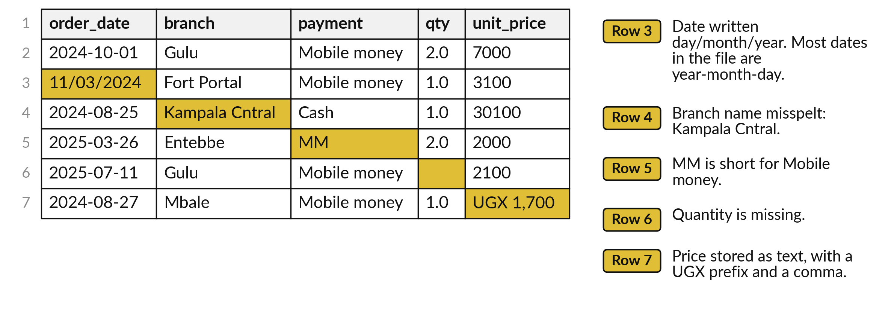
A raw export is messy: three payment
methods appear under 11 spellings
A raw order-line export (orders_raw.csv). Gold cells are the problems. Session 8 cleans this file.
Notes:
Real exports are messy. This is a small piece of a raw order line export, the file we clean in Session 8. The gold cells are the problems. One date is written day, month, year while most are year, month, day. A branch name is misspelt. Mobile money appears as MM.
One quantity is missing, and one price is stored as text with the letters UGX in front. Across the whole file the three payment methods appear under 11 different spellings, and the eight branches under 26. A pivot table would treat each spelling as a separate group and quietly give you wrong totals.
Which of these would be hardest to spot in a file of forty thousand rows?

Slide 23





Six messy-data checks you can run
in Sheets before you trust a total
Problem | What we found | First check in Sheets
Blank cells | customer_id: 580 blank in orders | =COUNTBLANK(D2:D2001)
Dates stored as text | order_date in orders is text | =ISNUMBER(B2) gives FALSE
Inconsistent labels | 11 spellings of 3 payment methods (raw export) | =COUNTUNIQUE(range) in Sheets
Extreme values | Largest order 1,935,520 UGX, median 24,800 | =MAX(G2:G2001) and =MEDIAN(G2:G2001)
Duplicate records | 80 exact duplicate lines (raw export) | =ROWS(range)-ROWS(UNIQUE(range)) in Sheets
Numbers stored as text | UGX 1,700 in unit_price (raw export) | =ISNUMBER(cell)
Notes:
Here are six checks you can run on any table before you trust a total, each with the Sheets formula and a real finding. Blank cells: COUNTBLANK found 580 in customer id. Dates stored as text: ISNUMBER on an order date returns FALSE. Inconsistent labels: the raw export has 11 spellings of three payment methods, which COUNTUNIQUE reveals in Sheets.
In Excel 365 use COUNTA of UNIQUE of FILTER. Extreme values: the largest order is 1,935,520 shillings against a median of 24,800. Duplicates: the raw export has 80 exact duplicate lines. And numbers stored as text, like UGX 1,700. In the lab you will run the first, second and fourth of these.
Which check would you run first on a file someone emails you?

Slide 24
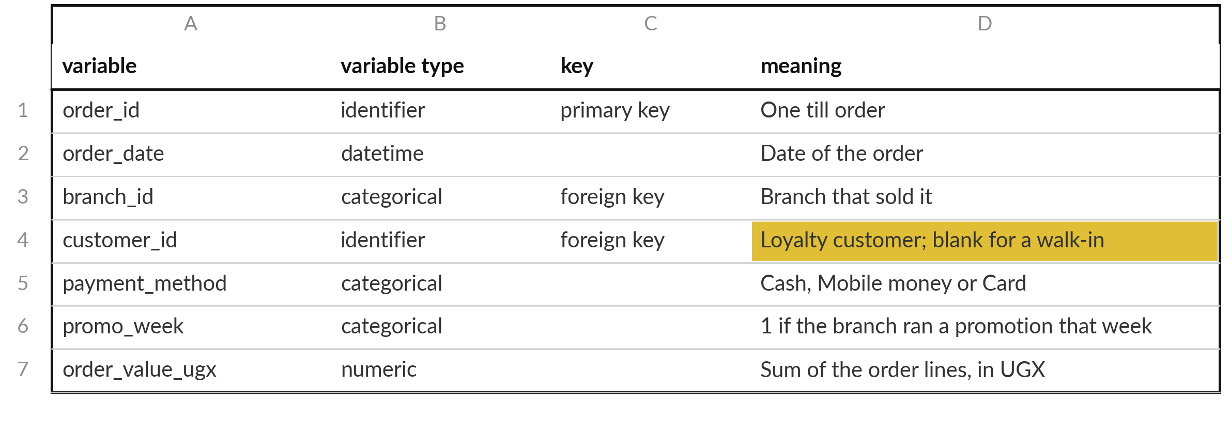
A data dictionary says what each
variable means, its type and its key
The orders tab, written as a data dictionary. You write one for every tab in the lab.
Notes:
The last idea is the data dictionary. It is a short document that explains every variable in a table: its meaning, its variable type and its key. Look at the orders tab written as a dictionary. The gold cell is the one that saves you from a wrong decision.
It says that customer id is blank for a walk-in, so you do not delete or fill those records. Without that line, someone would call the blanks an error. The full Lakeside dictionary comes with your workbook files. A good dictionary lets a new colleague read the table without asking you anything.
In the lab you start your own dictionary tab. What would you add to it for your own data?

Slide 25



Where you will use this at work: check
keys and granularity before you report
Your job | The tables you meet | What today lets you do
Credit analyst at a bank in Kampala, using SQL | loans: one record per loan (loans.csv). | Check loan_id is unique before you join it to anything, so no loan is counted twice.
Health records officer at a district office, using pandas | Monthly clinic reports: 18 of 720 district-months blank in our file. | Tell a blank (not reported) from a zero before you total a district.
Sales analyst handing a workbook to Power BI | Orders, order lines and branches. | Mark each key first, so the relationships in Power BI do not multiply totals.
Officer at a SACCO or coffee cooperative, using Excel | Member register, deliveries and payments. | Draw the ERD and write the data dictionary, so a new colleague can read the workbook.
Notes:
Where will you use this on Monday?
Four examples. A credit analyst at a bank in Kampala who uses SQL should check that loan id is unique before joining the loans table to anything, so that no loan is counted twice. A health records officer at a district office who uses pandas has monthly reports where a blank means not reported, which is different from a zero.
Our clinic file has 18 blank months out of 720. A sales analyst who hands a workbook to Power BI should mark every key first. And an officer at a SACCO or a coffee cooperative using Excel can draw the diagram and write the dictionary so that a new colleague understands the workbook.
Which of these is closest to your job?

Slide 26
Read the recipe before the
lab: five formulas test a table
In plain words
=COUNTA(A2:A2001)
=COUNTA(UNIQUE(A2:A2001))
=COUNTBLANK(D2:D2001)
=COUNTIF(E2:E2001,"Mobile money")
=ISNUMBER(B2)
Line 1 counts the filled cells of order_id: 2,000 records.
Line 2 counts the different values. Equal to line 1 means a primary key.
Line 3 counts the empty cells of customer_id: 580.
Line 4 counts the orders paid by Mobile money: 976.
Line 5 is TRUE for a real date or number. Here it is FALSE: the date is text.
Notes:
Before the lab, read the five formulas that do most of the work. Line one, COUNTA of A2 to A2001, counts the filled cells in the order id column, which gives 2,000. Line two counts the different values: if it equals line one, the variable can be a primary key.
Line three, COUNTBLANK on the customer column, counts the empty cells and gives 580. Line four, COUNTIF, counts the records where the payment method is Mobile money, 976. Line five, ISNUMBER on B2, says whether the date is a real date, and here it says FALSE. Tab names go in front of the range with an exclamation mark, like orders!A2:A2001, when you work from another tab.
Which formula would you use to count orders paid by cash?

Slide 27
Part 2: the Sheets lab
Close the slides. Open the sheet.
Notes:
That is the end of the ideas. Everything you need is on the slides you have just seen, and the lab sheet repeats each step. Open the Lakeside Mart workbook in Google Sheets, or in Excel if you prefer. The file is called lakeside for sheets. Add a new tab and call it dictionary.
You will write on it as you go. In every task, predict the answer first, then check it with a formula, then write what you found.

Slide 28
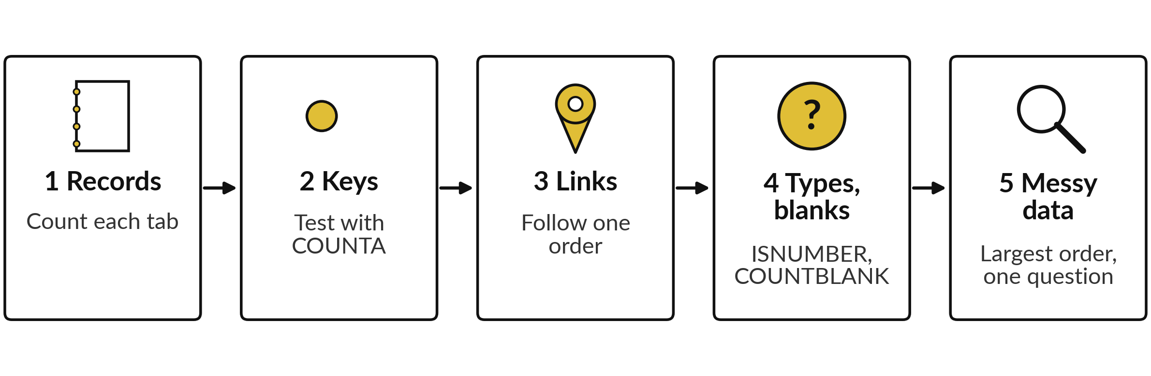
The lab has five steps, and you
keep a dictionary tab at the end
Ten tasks in 45 minutes. For each task, predict the answer, check it with a formula, then write it on your dictionary tab.
Notes:
Here is the map of the lab. Step one, count the records of each tab and write what a record is. Step two, test the keys with the two counts, including the composite key of branch weeks. Step three, check the foreign keys and follow order O000003 through the tabs.
Step four, label the variable types, count the blanks, and test whether the date is a real date. Step five, find the largest order and write one question for the owner of the data. In every task, predict first, check with a formula, and write the answer on the dictionary tab. Please do not skip the predictions.

Slide 29








Check your numbers before you move on
What you compute | You should get
Records in the six tabs, in the order of the table on slide 10 | 2,000, 6,590, 150, 8, 2,500, 832
Different order_id values in orders | 2,000: a primary key
Lines per order on average, and in O000003 | 3.3, and 2
Different branch_id, week_start and pairs in branch_weeks | 8, 104 and 832
Blank customer_id in orders, and its share | 580, which is 29 percent
Different customer_id values among the 1,420 filled | 1,082
ISNUMBER of an order_date | FALSE
Largest order_value_ugx, and the median | 1,935,520 and 24,800
If your number differs, find the task that went wrong. Do not change a number to match.
Notes:
Use this table as your own self-check. Nobody marks it. If your numbers match, carry on. If one does not, stop and call me, because later tasks use the earlier ones. The most common cause is a range that includes the header row, which makes every count one too big, or a range that stops too early.
Do not change a number to make it match. Find out why it is different. What does it mean if your count of different customers is higher than the table says?

Slide 30

Five likely mistakes in the lab and how to fix them
What you see | What it means | What to do
A count of 2,001 where you expected 2,000 | The range includes the header cell in row 1. | Start the range in row 2: A2:A2001.
#REF! or #NAME? when you point to another tab | The tab name is missing or misspelt. | Write the tab, then !, then the range: orders!A2:A2001.
#N/A from VLOOKUP | The key was not found, or FALSE is missing. | Add FALSE as the last argument. Check for stray spaces.
Array result was not expanded | Cells below the UNIQUE formula hold data. | Clear them, or move the formula to an empty column.
ISNUMBER on a date gives FALSE | That is correct: the date is stored as text. | Write it on your dictionary tab as a finding.
Notes:
Five messages you may meet. A count that is one too big means your range includes the header row, so start in row 2. Hash REF or hash NAME when you point to another tab means the tab name is missing or misspelt, so write the tab, an exclamation mark and then the range.
Hash N A from VLOOKUP means the key was not found, or you forgot FALSE as the last argument. The message array result was not expanded means the cells below a UNIQUE formula already hold data, so clear them. And ISNUMBER returning FALSE on a date is correct, because the date is stored as text.
That one is a finding, so write it down. Read the message first. It usually tells you the answer.

Slide 31


Exit check: three questions, then
compare with the short answers
Question | Short answer
Order O000003 has 2 products. How many records does it make in orders, and how many in order_lines? | One record in orders and 2 in order_lines. The two tabs have different granularity.
Which variable is the primary key of products, and which tab holds it as a foreign key? | product_id. The order_lines tab holds product_id as a foreign key.
customer_id is blank on 580 orders. What do you do first? | Read the data dictionary: the blank means a walk-in. Keep the records and add a flag, instead of deleting or filling them.
Notes:
Last, the exit check. Three questions. Write your answers in your notes before you look at mine. One, an order has two products: how many records does it make in orders and how many in order lines?
Two, which variable is the primary key of products, and which tab holds it as a foreign key?
Three, the customer id is blank on 580 orders: what do you do first?
The short answers are on the slide. If you got all three, you are ready for session three. If one surprised you, look at that part of your dictionary tab again tonight.

Slide 32
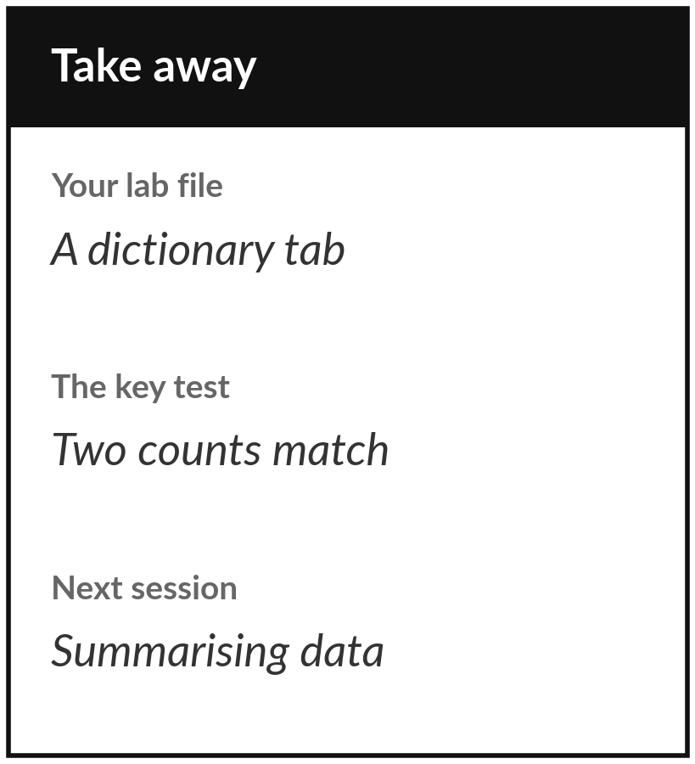
Save your workbook with its dictionary tab
What you keep from today
Keep your dictionary tab: for each of the six Lakeside tabs, one sentence saying what a record is, its key, and the problems you found, each with a number.
Our question today
What exactly is one row of a table, and how does one table connect to another?
Next session
Session 3: Summarising and showing data fairly. We describe thousands of records with a few numbers and one chart.
Notes:
Before you go, save your workbook with the dictionary tab. That tab is your keepsake from today: one sentence per table saying what a record is, the key of each table, and three problems with a number each. If you can show it to a colleague and they understand the workbook without asking you anything, it is good.
Next session we use these tables to summarise thousands of records in a few numbers and one honest chart. If anything was unclear today, write the question down and bring it.
We began with this question: What exactly is one row of a table, and how does one table connect to another? Before you go, say in one sentence what you can now say about it.

